Slide 1

Gorgeous Greek
Let's investigate a different way of writing

Slide 2

Objectives
We can substitute Latin and Greek letters of the alphabet.
We can see that we use lots of Greek words in English today. Some say there are over 150,000 English words that come from Greek words!
We can have fun cracking linguistic codes.

Slide 3
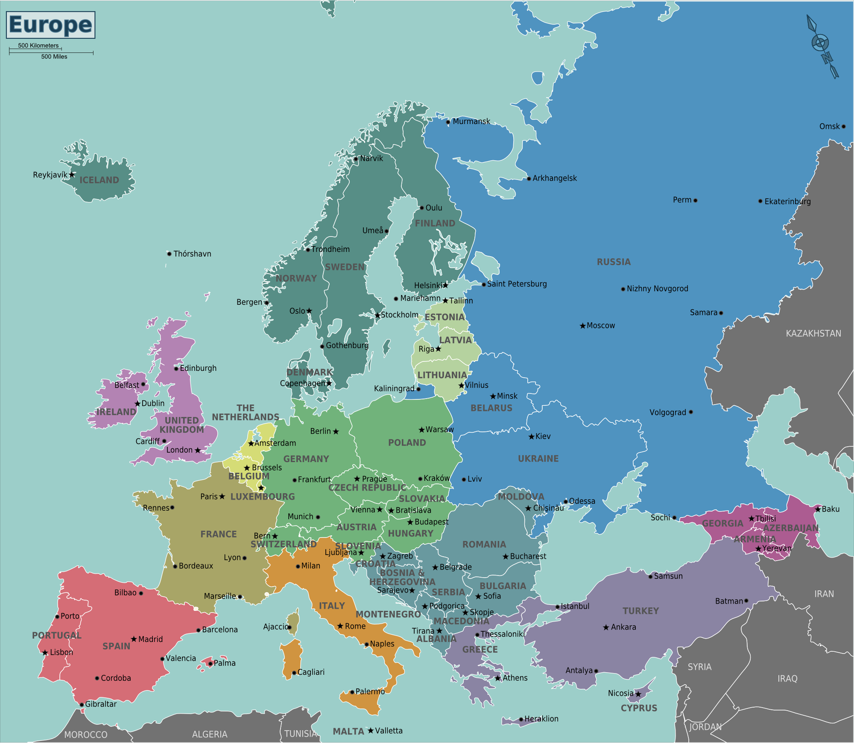
Let's Go!
Do you know any Greek words?
Do you know any Greek letters?
Do you know where Greece is on a map of Europe?
Has anyone been to Greece?

Slide 4
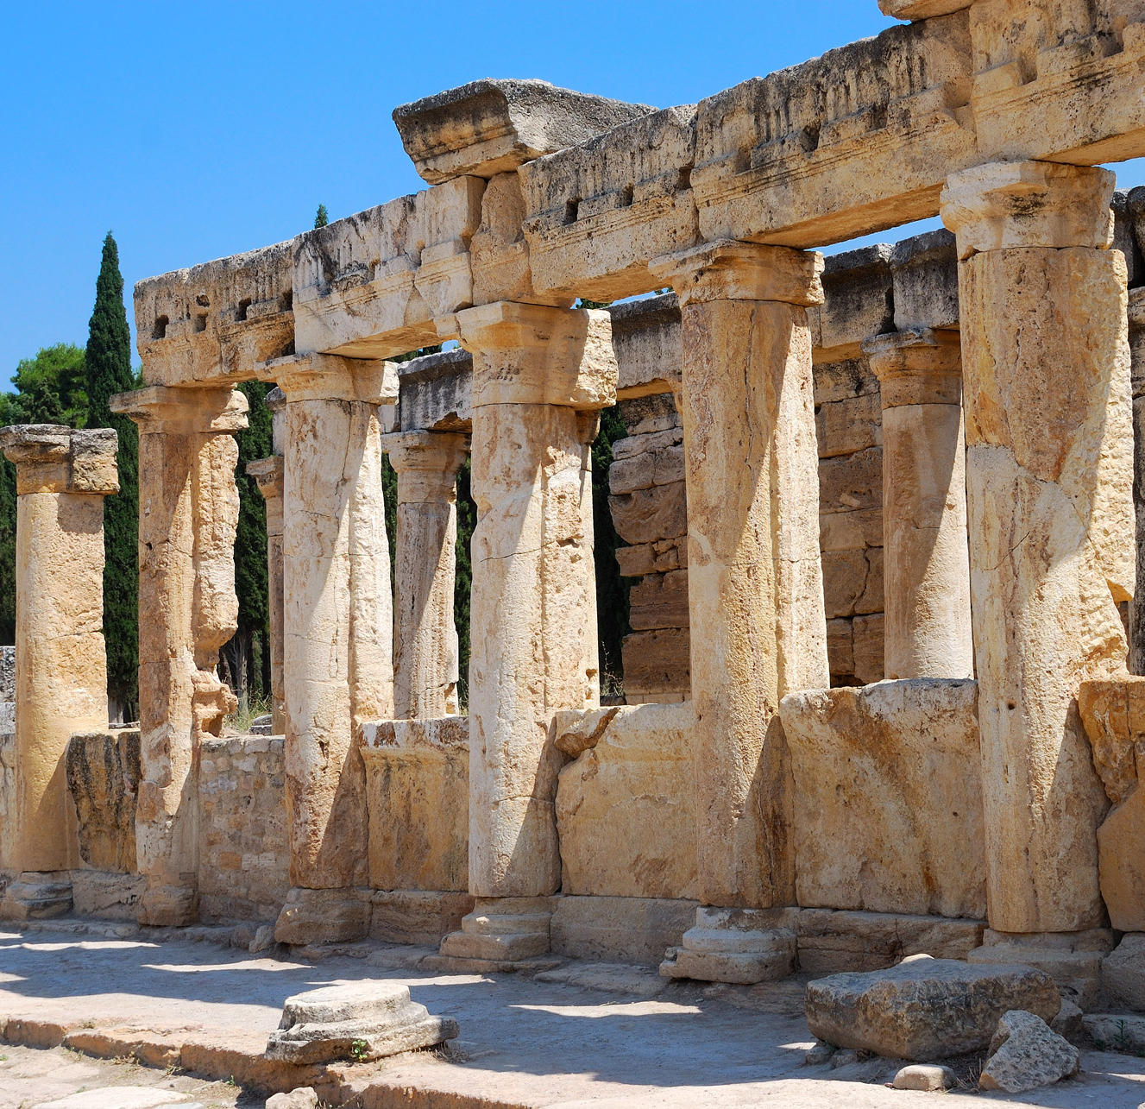
Where do we see Greek in English?
Greek has influenced the English language through mythology, art and literature. Take the Greek demi-God Achilles for example – do you know what an "Achilles heel" is?
We see lots of Greek words used in science such as biology, chemistry, astrology, and botany.
We see Greek prefixes used for example anti-, hyper-, infra-. Can you think of words that use these prefixes?

Slide 5
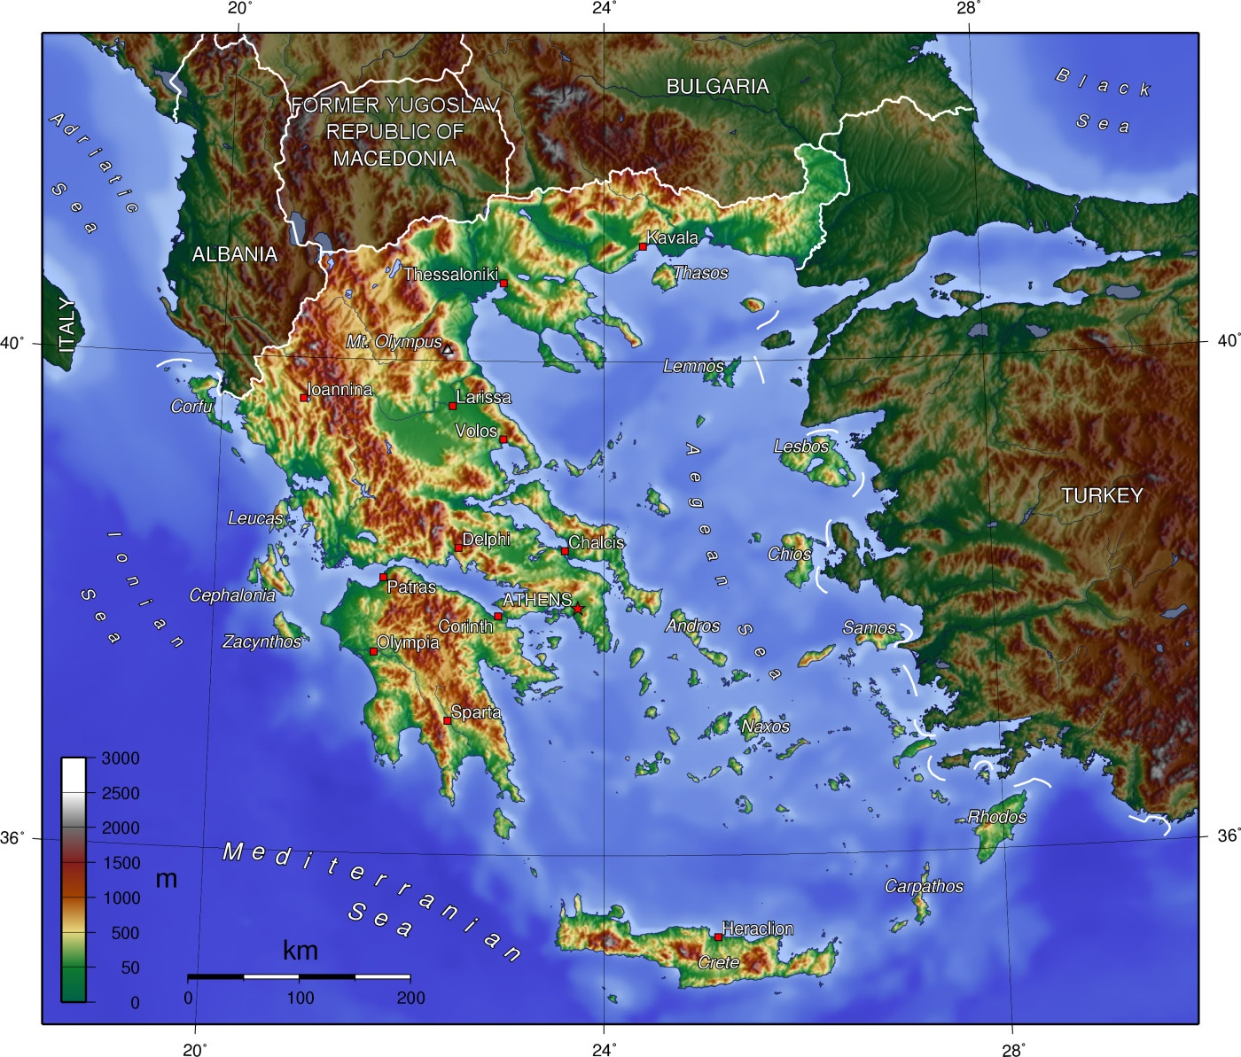
Today's challenge is to work out the Greek alphabet with no help from the teacher!
You'll see several clues.
Work out which letter of our alphabet matches the letter in the Greek alphabet.
Use the grid in your workbook to help you.

Slide 6
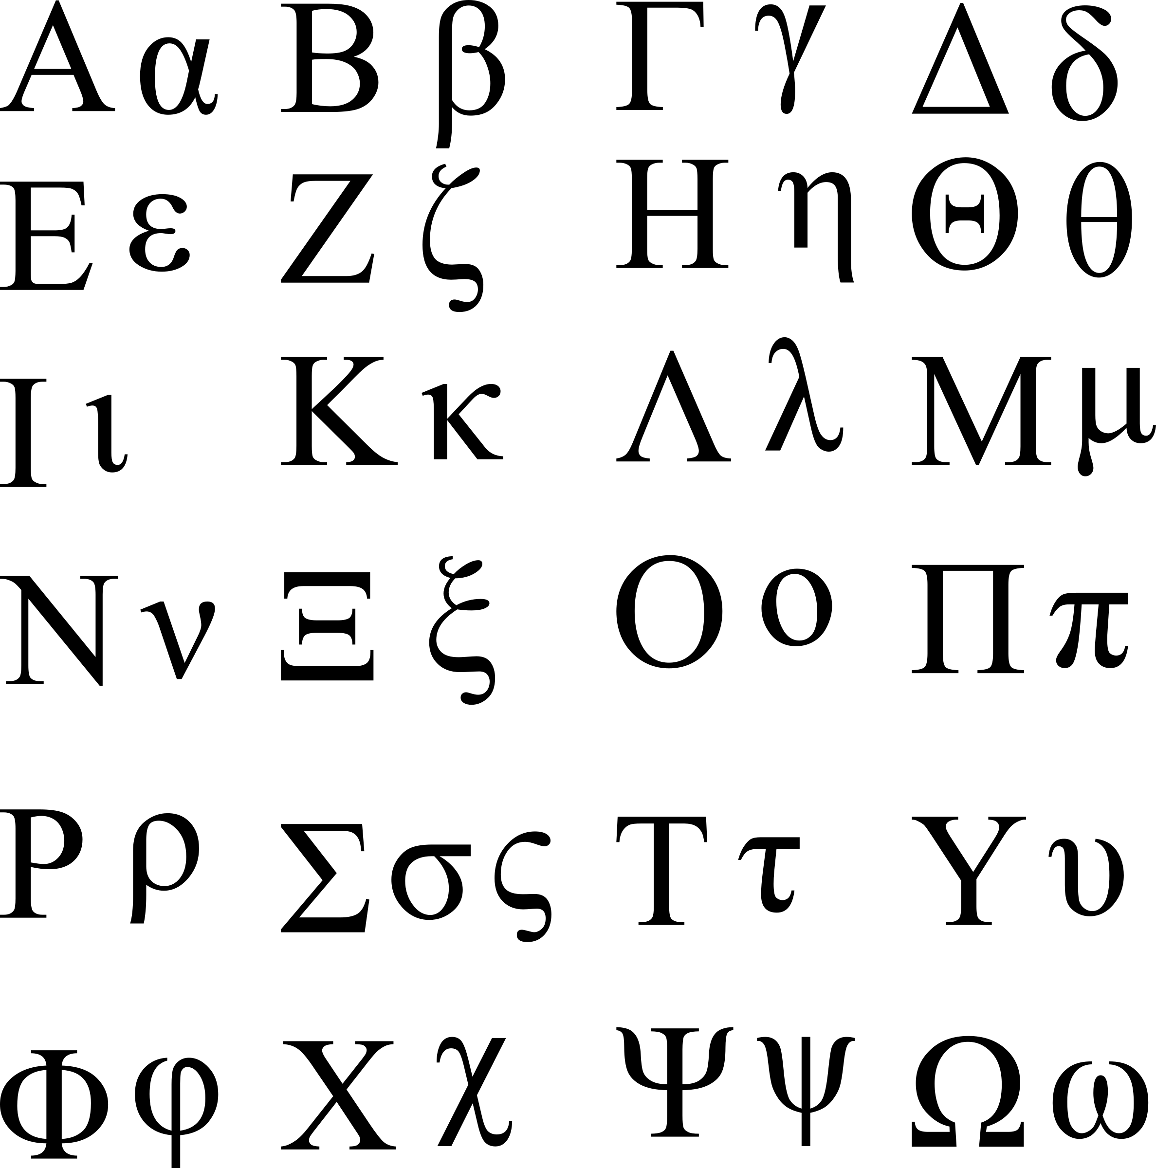
The Greek alphabet looks different from ours.
You may notice some similarities but reading words in Greek would be very tricky.
Or is it....?

Slide 7
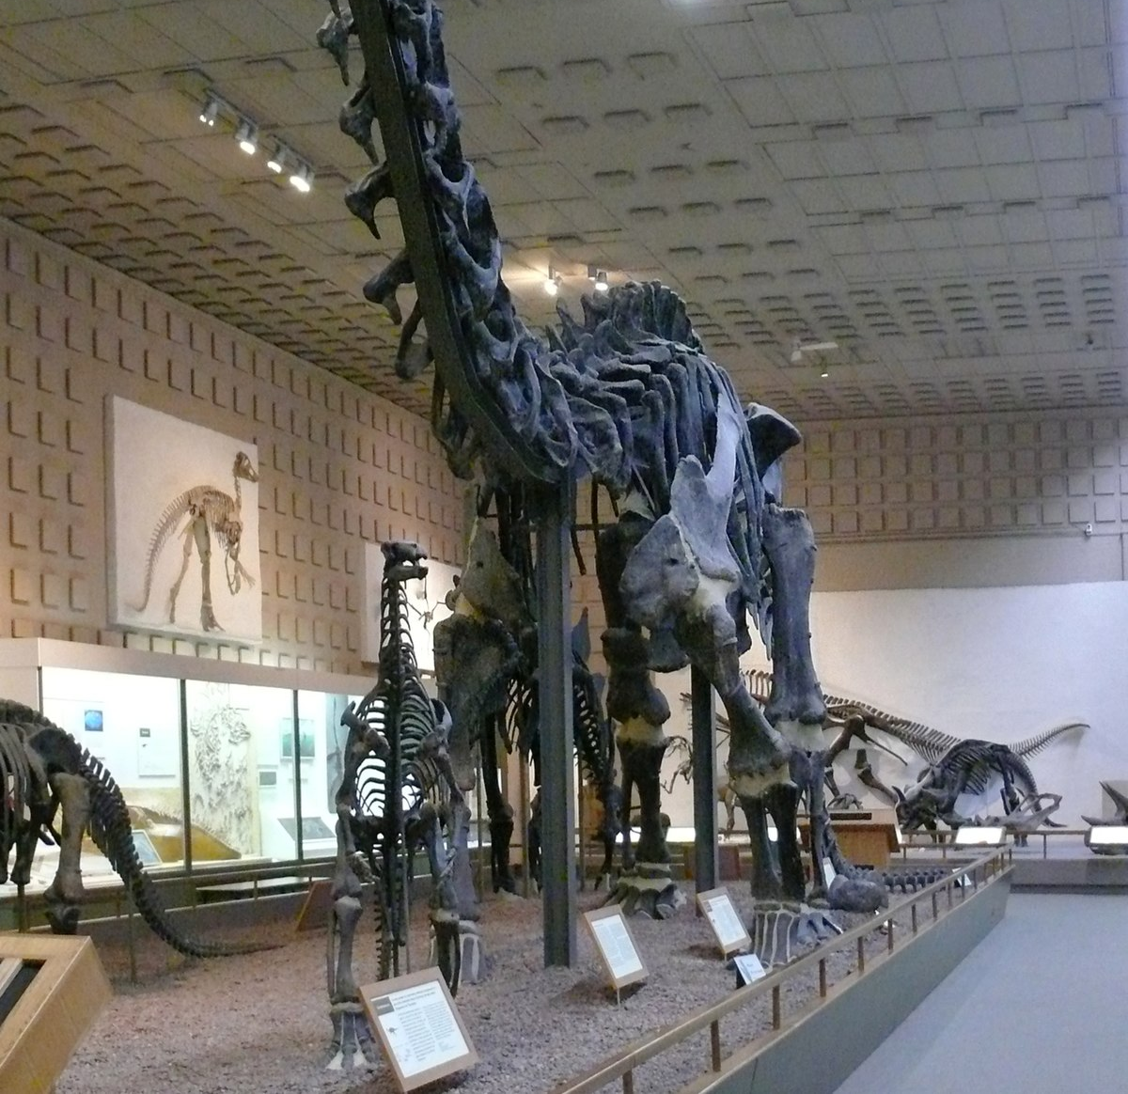
What does this mean?
Δεινοσαυρος
βροντοσαυρος

Slide 8
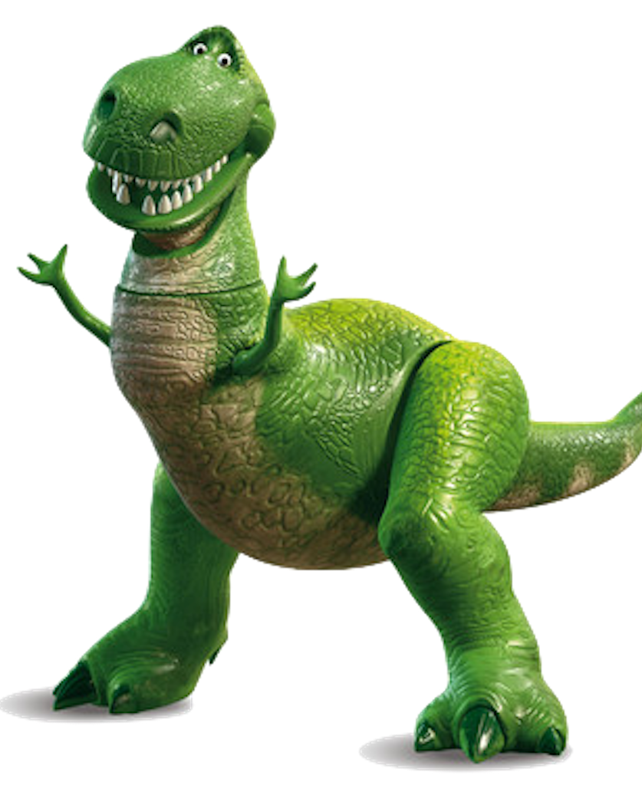
What could this mean?
Τυραννοσαυρος
Rex

Slide 9
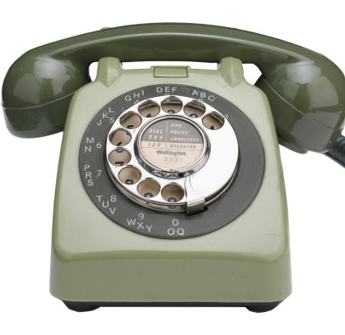
And this?
Τηλεφωνη

Slide 10
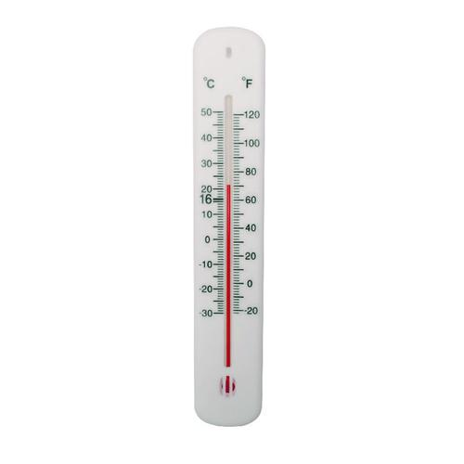
Guess what this means!
θερμομετρον

Slide 11
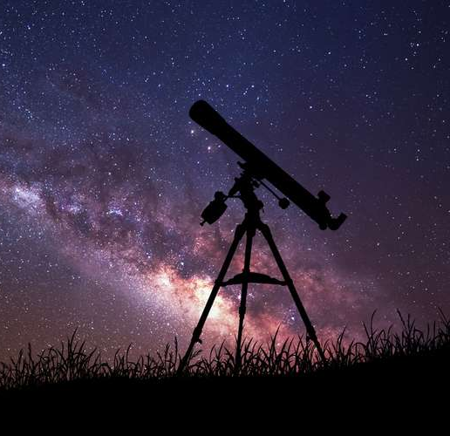
And I bet you can work this one out!
τηλεσκόπιο

Slide 12
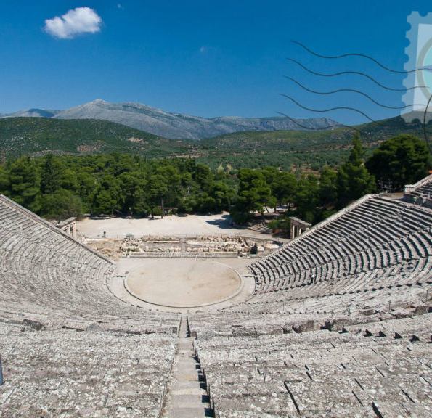
This one is a little harder.
θεατρον

Slide 13
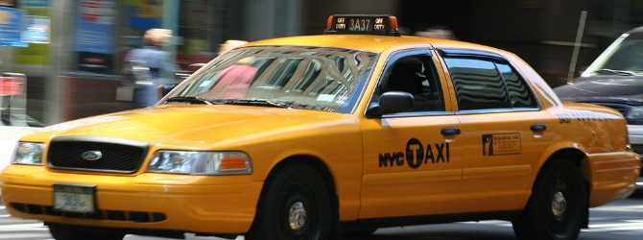
And this one is a little easier.
ταξι

Slide 14

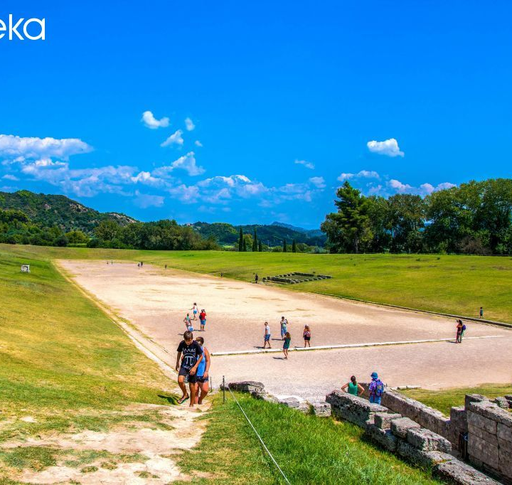
So, what does this mean?
Ολυμπικα

Slide 15
Here's your final one (which you have seen before...)
ἱπποπόταμος

Slide 16
Fill in the grid with the Greek letters.
a | b | c | d | e | f | g | h | i | j | k | l | m | n | o | p | q | r | s | t | u | v | w | x | y | z | th | ps
 |  | - |  | ε η | φ |  | - |  | - |  |  | μ |  | ο ω |  | - |  |  |  |  | - | - |  | - |  | θ | ψ
Now have a go at spelling these words using Greek letters:
1. Cathedral
2. Holiday
3. Appointment
4. Parthenon
5. Greek
Now give your partner three tricky spellings to "transliterate".

Slide 17
Can you write the names of these Greek gods and goddesses as the Ancient Greeks would recognise them?
Remember to use a capital letter at the beginning.
Do you know who these gods are? If not, it's fun to research!
Zeus …………………………………… Hera …………………………………………
Apollo ………………………………….. Poseidon …………………………………...
Dionysos ……………………………… Artemis ……………………………………..
Demeter ………………………………. Hermes ……………………………………..
Hades …………………………………. Aphrodite ……………………………………

Slide 18
You – in Greek!
Try writing out your own name (in full!) using the Greek alphabet.
(Don’t forget to put in the capital letters.)
My full name in the My full name in the
Latin (English) alphabet Greek alphabet
………………………………………….. ……………………………………………….
………………………………………….. ……………………………………………….
………………………………………….. ………………………………………………..
………………………………………….. ………………………………………………..

Slide 19
A final quiz question...
These Greek words have specific meanings
bronte = thunder
turannos = king
So, why is a Brontosaurus called such? What about a Tyrannosaurus Rex?

Slide 20
WoLLoW would like to know...
Can you ask your partner a question about today's lesson?
Can they give you a correct answer?
Thanks to Simon Thomas.

