Slide 1

Numerals and Numbers

Slide 2

Objectives
We will investigate numerals in different languages
We will make educated guesses as to what number comes next
We will investigate similarities and differences in writing numbers and in counting

Slide 3
Let's go....it's question time!
Do all languages write numbers down in the same way?
What is a numeral?
How do you write the numbers one to ten in numerals in English?

Slide 4
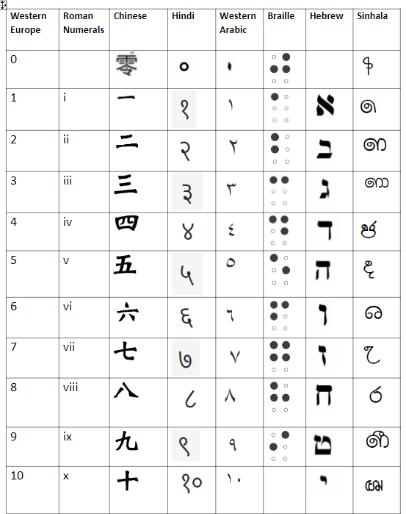
Take a look at this. What do you notice?
(It's bigger on your worksheet!)

Slide 5
Let’s get thinking...
Why is there no 0 for Hebrew or Roman numerals?
Look carefully at Western Arabic and Western Europe. Can you see a link between the numbers 1, 2 and 3?
How might you write 11 in numerals in these languages?
Do you know any others to add to the grid?

Slide 6
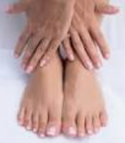
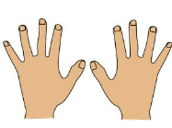
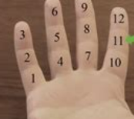
How do we count?
Base 10....Using our ten fingers. It's our decimal system.
Base 12...Using the parts of fingers on one hand. This method is used in Chepang in Nepal.
Base 20...Using fingers, thumbs and toes. This method is used in Aztec and Mayan areas.
Base 27...Using all your body parts. This method is used in Central New Guinea.
Over to you: Have a go at counting in these different ways. Try adding up using these methods.

Slide 7
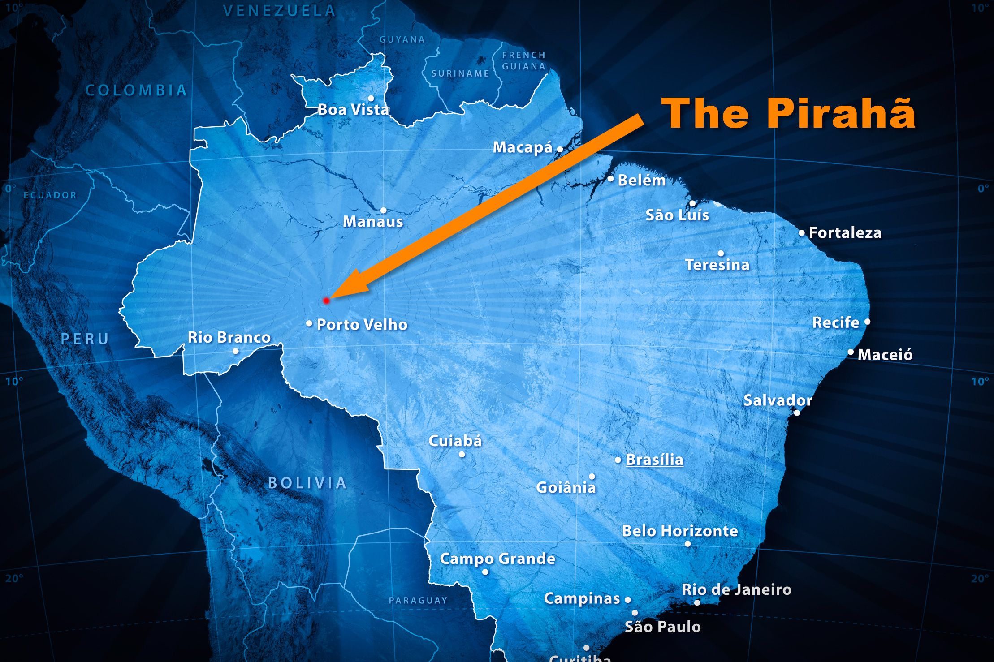
Counting many...
Here's an amazing fact:
The Piraha of the Amazon in South America only count one, two and then "many".
What challenges do you think this might create?

Slide 8
And what about this? What do you notice?
Which languages are the most and least similar? Why is this?
Latin | English | French | Spanish | German | Dutch | Swedish | Portuguese | Icelandic
ūnus | one | un | uno | ein | een | en | um | einn
duo | two | deux | dos | zwei | twe | två | dois | tveir
trēs | three | trois | tres | drei | drie | tre | três | þrír
quattuor | four | quatre | cuatro | vier | vier | fyra | quatro | fjórir
quīnque | five | cinq | cinco | fünf | vijf | fem | cinco | fimm
sex | six | six | seis | sechs | ses | sex | seis | sex
septem | seven | sept | siete | sieben | zeven | sju | sete | sjö
octō | eight | huit | ocho | acht | acht | åtta | oito | átta
novem | nine | neuf | nueve | neun | nejen | nio | nove | níu
decem | ten | dix | diez | zehn | tien | tio | dez | tíu

Slide 9
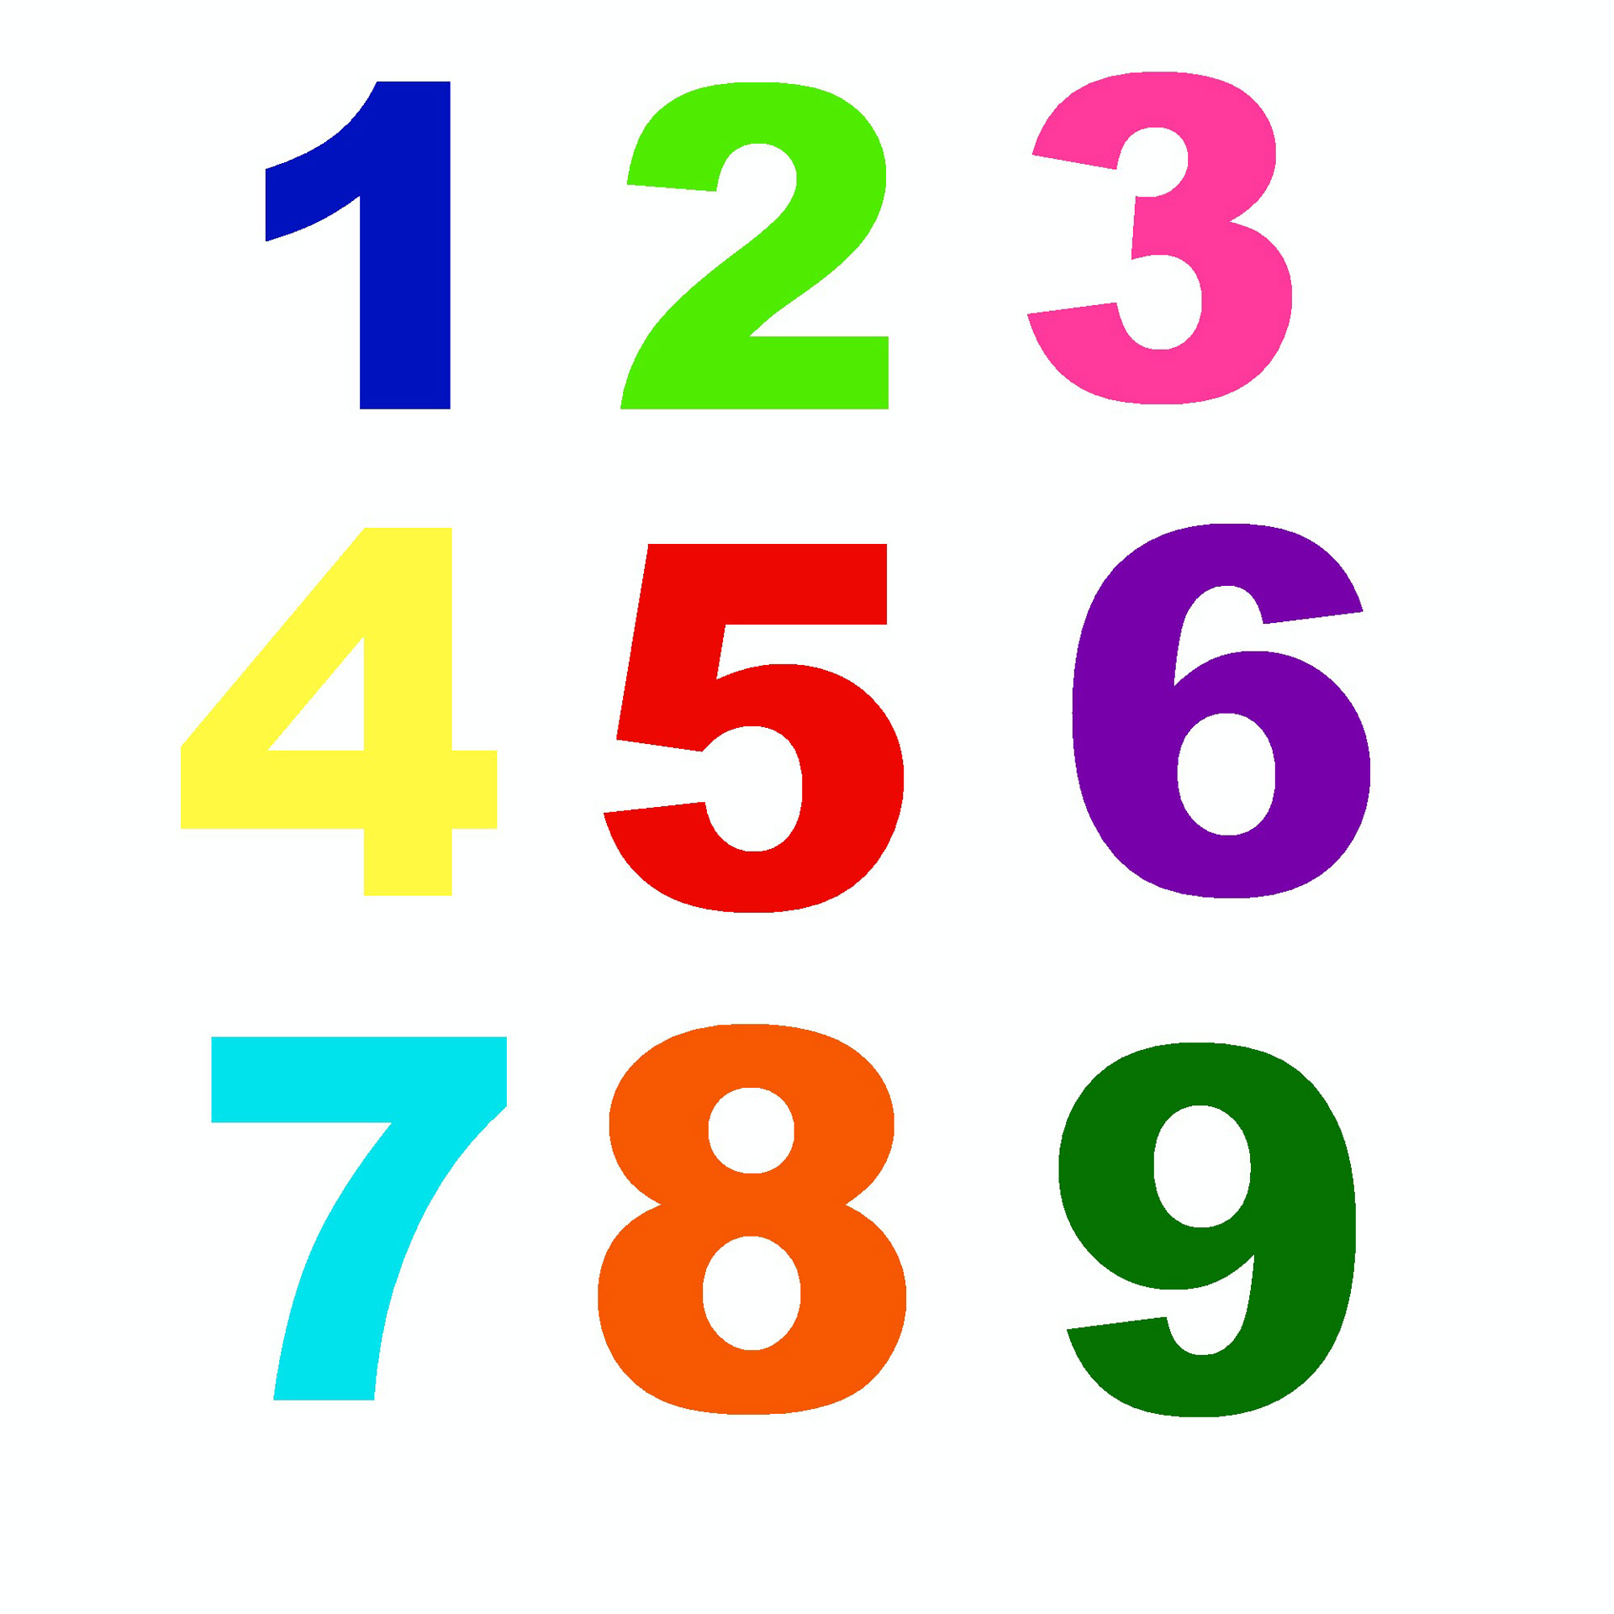
Time to race: Ready, steady, go...
Choose a language from the grid. Who can recite the numbers 1 to 10 the quickest?
Think of the language you are learning in school. Who can recite those numbers backwards the quickest?
Who here knows how to say 1 to 10 in another language? Teach it to your classmates. Who can say them accurately and the quickest?
Choose a language and give your partner some arithmetic questions to solve quickly. (You'll have to ensure the number comes to between 1 and 10.) For example, what is neun – vier? (The answer is fünf.)

Slide 10
WoLLoW would like to know...
What three things will you take away from this lesson?
1.
2.
3.

