Slide 1

Welcome to WoLLoW

Slide 2

Objectives
We can see that words and languages are fascinating and fun!
We can see that words and languages from different countries are linked.
We can see that understanding other languages is easier than we think by looking for clues and cracking codes.

Slide 3

Let's Go!
Can we break the code?
Can you guess what the word under the hippo means?
What do you notice about the letters?
Are there any similarities to English?
What language do you think it might be?

Slide 4
So, if means Hippopotamus in Greek….
ἱπποπόταμος
Meet WoLLoW the HiPPo.
How would you write "mat" using Greek letters?
What about "pop" and "pot"?
What other words can you find within the word? Are there any of more than 3 letters?
Write the words you have found out in Greek letters. Can your partner crack the code and work out what they mean?

Slide 5

What can you tell me about this Greek letter?

Slide 6
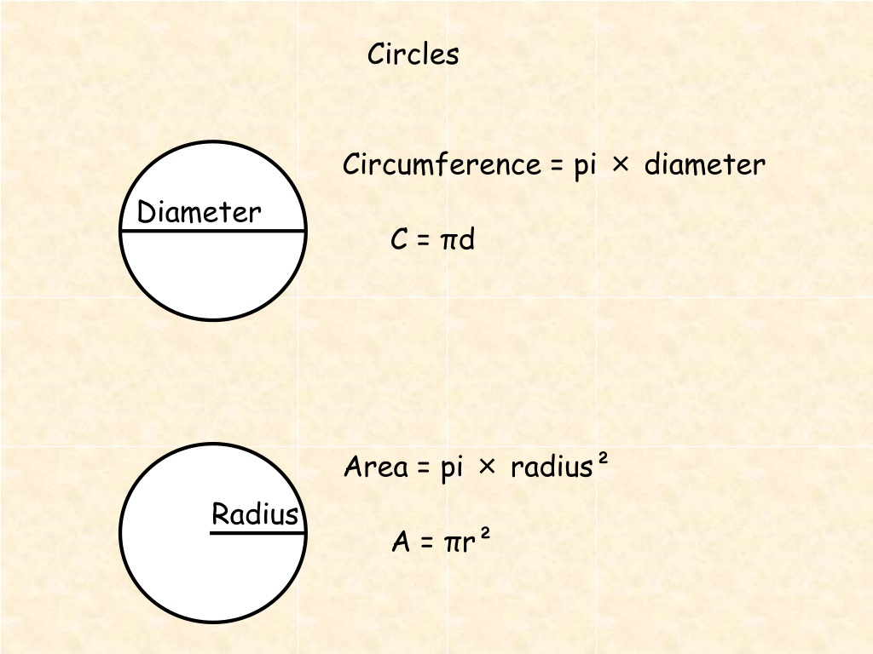
π
3 . 1 4 1 5 9 2 6 5 3 5 8 9 7 9 3 2 3 8 4 6 2 6 4 3 3 8 3 2 7 9 5 0 2 8 8 4 1 9 7 1 6 9 3 9 9 3 7 5 1 0 5 8 2 0 9 7 4 9 4 4 5 9 2 3 0 7 8 1 6 4 0 6 2 8 6 2 0 8 9 9 8 6 2 8 0 3 4 8 2 5 3 4 2 1 1 7 0 6 7 9……..

Slide 7


Now, let’s crack a code in German.
Hippopotamus means 'river horse' in Greek. Which part of the word do you think means 'horse' and which part means 'river'?
In German, a hippopotamus is a Nilpferd. Pferd means horse, so what does Nil mean? Remember that this Hippo was found in Egypt!

Slide 8
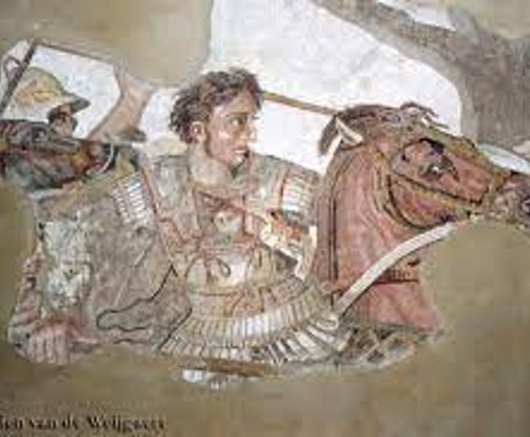
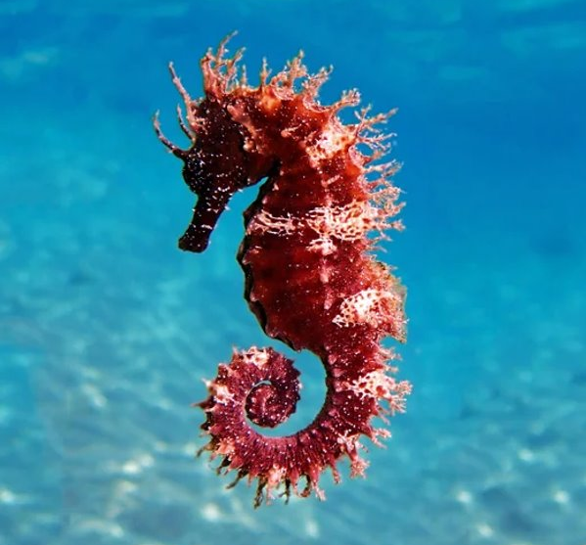
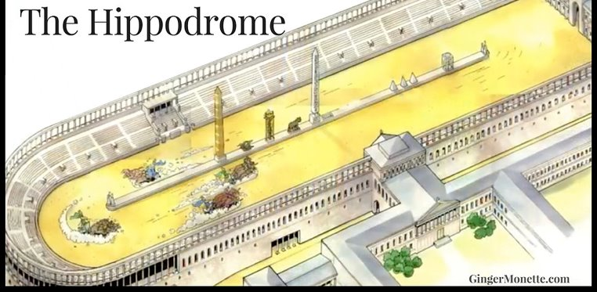
Hippos means horse; Potamus means river. So...
What’s a Hippodrome?
What does the name Philip mean?
The hippocampus can be found in the brain and the sea. Why?

Slide 9
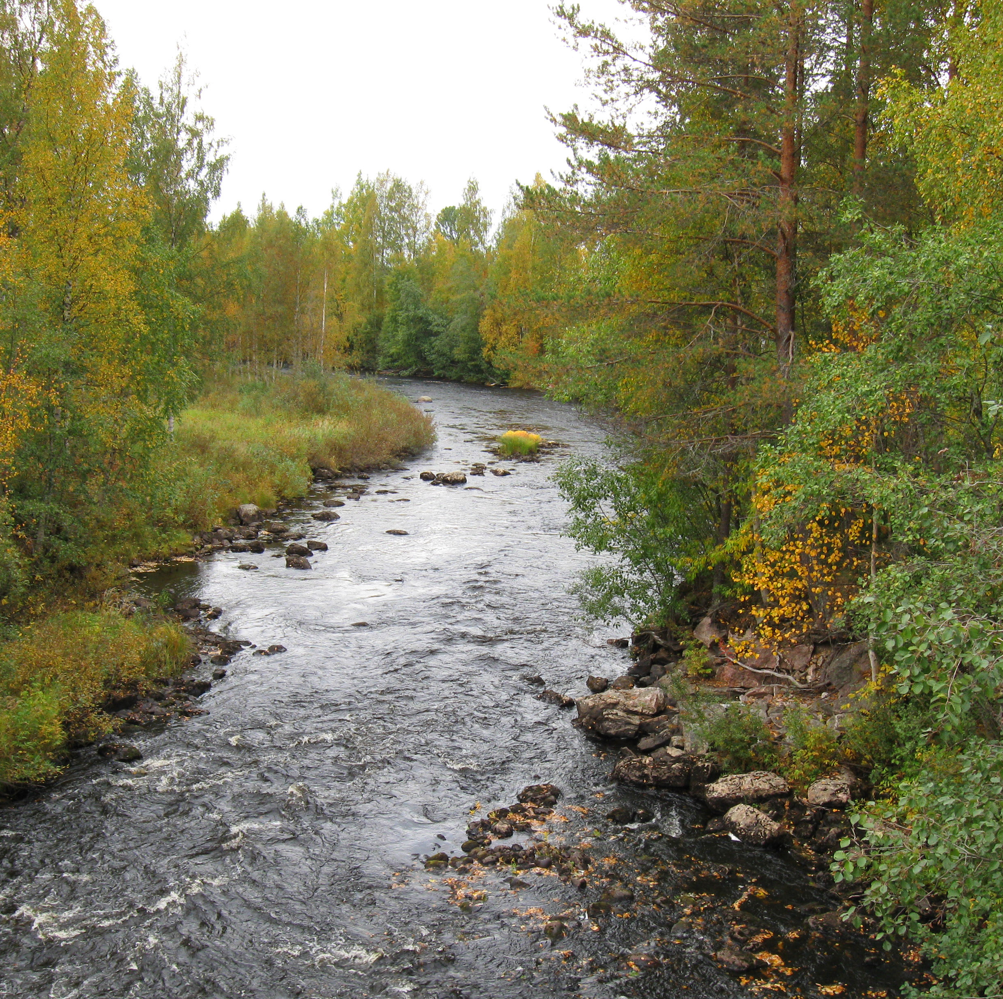
Match the language to the word!
All these words mean the same thing. What could it be?
نَهْر
Río
Flod
Fleuve
Ποταμός
河流
Can you add any languages to the list?
Chinese
Spanish
Arabic
Greek
French
Danish and Swedish

Slide 10
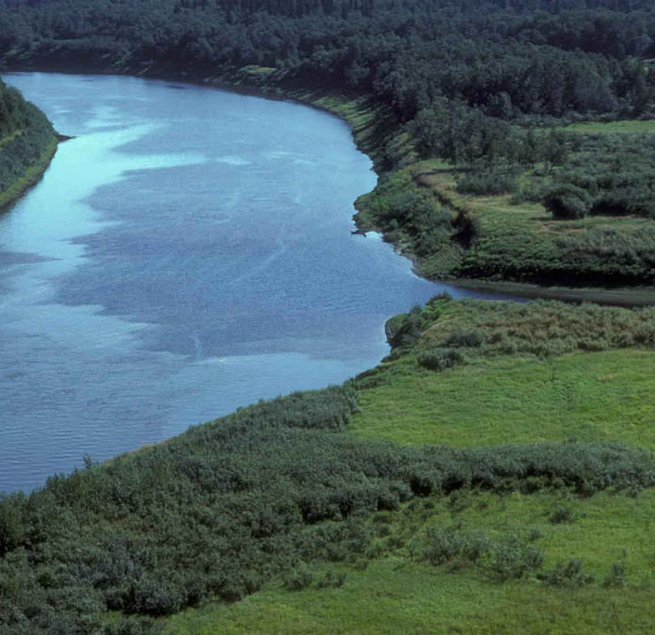
Flod
Does Flod remind you of any English words?
Why is the Danish and Swedish for 'river' the same?
Do you know how language from Denmark influenced English?
Arabic and Greek use a different alphabet. Chinese uses characters. Can you think of other languages that use different scripts?

Slide 11
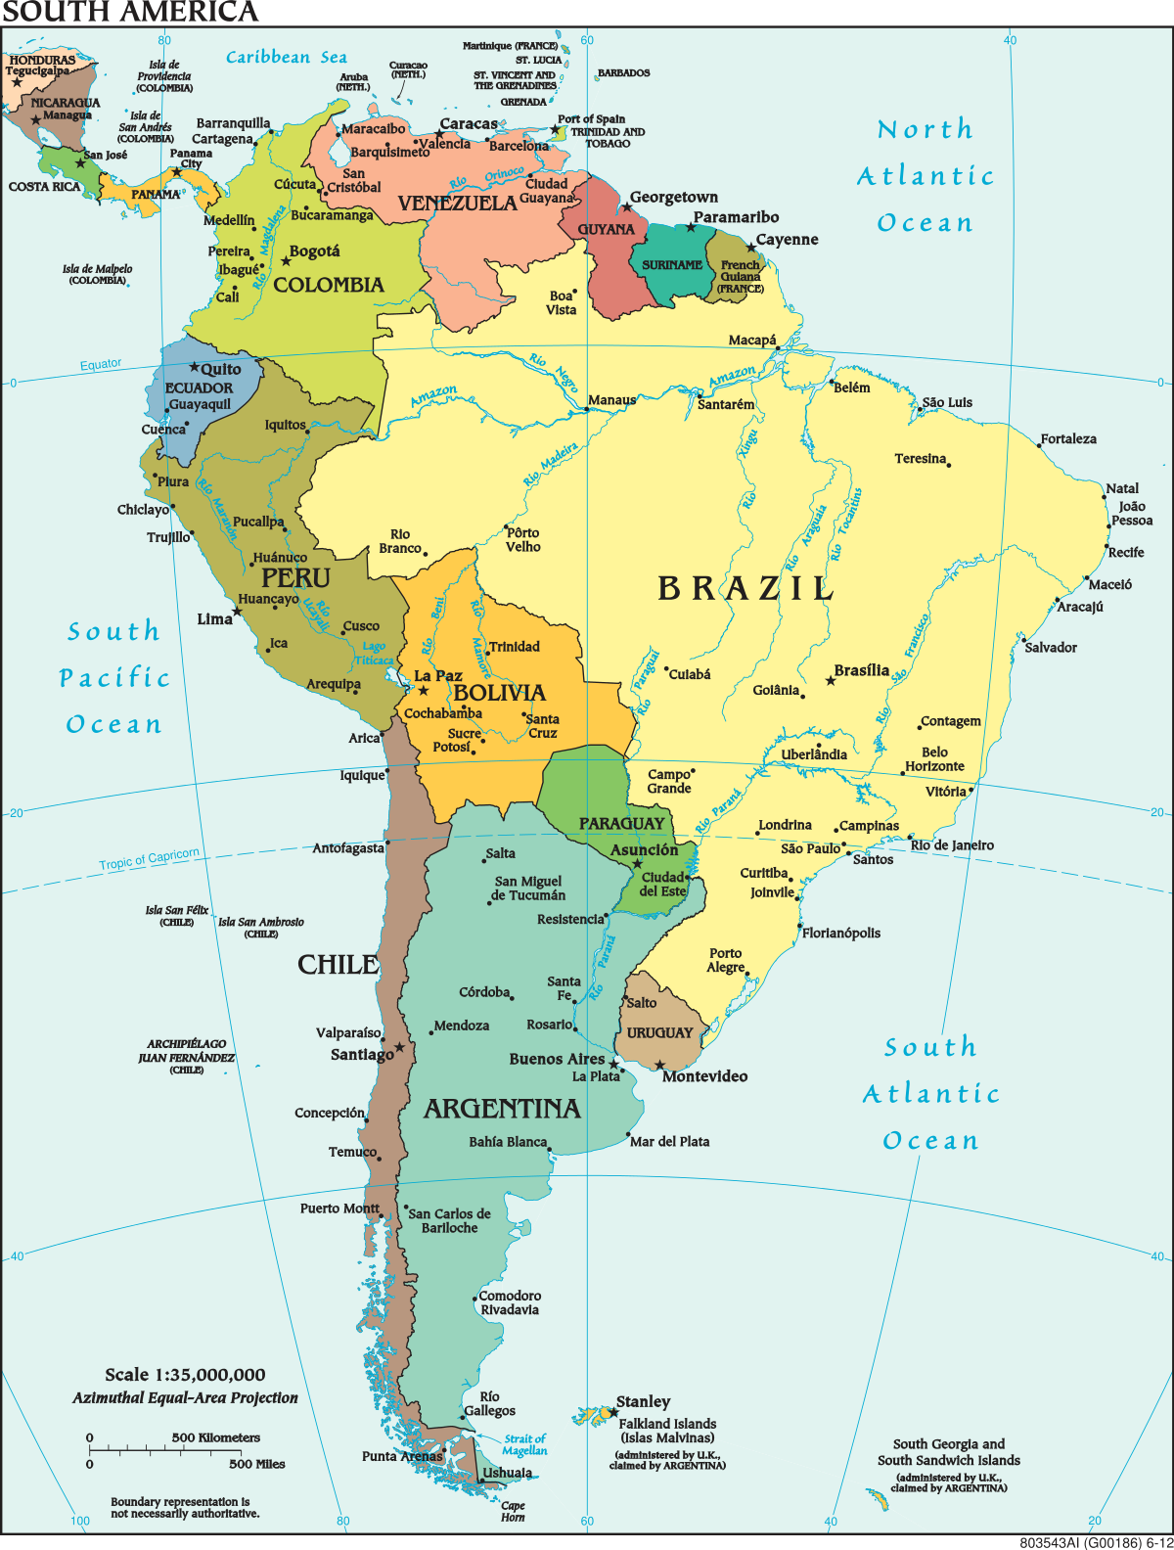
Río
Argentina, Chile, Colombia, Costa Rica, Cuba, Guatemala, Mexico, Nicaragua, Paraguay, Peru, Spain, Uruguay, and Venezuela.
What language links these countries?
Where are most of them located on a map?
Why is Brazil different?
Have you heard of Rio de Janeiro?

Slide 12
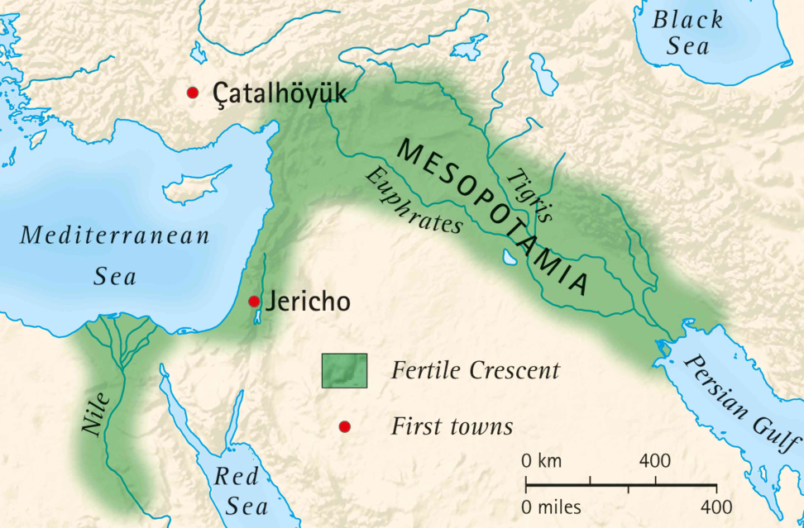
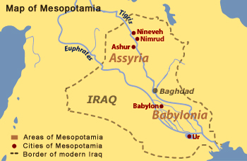
Mesopotamia: the land between two rivers
What is the Fertile Crescent?
Why did it matter?
Which modern countries are in the Fertile Crescent?
What is the capital of Iraq?
Which other countries border Iraq today?
In Arabic the area is called Al-Jazirah – ‘the island’

Slide 13

Hippos and Lions
In which continent do hippos live?
How many languages do you think are spoken on that continent?
Swahili is one of the most spoken languages in this continent. You may know some Swahili: Hakuna Matata and Simba. What do these words mean?
This Photo by Unknown Author is licensed under CC BY-SA

Slide 14
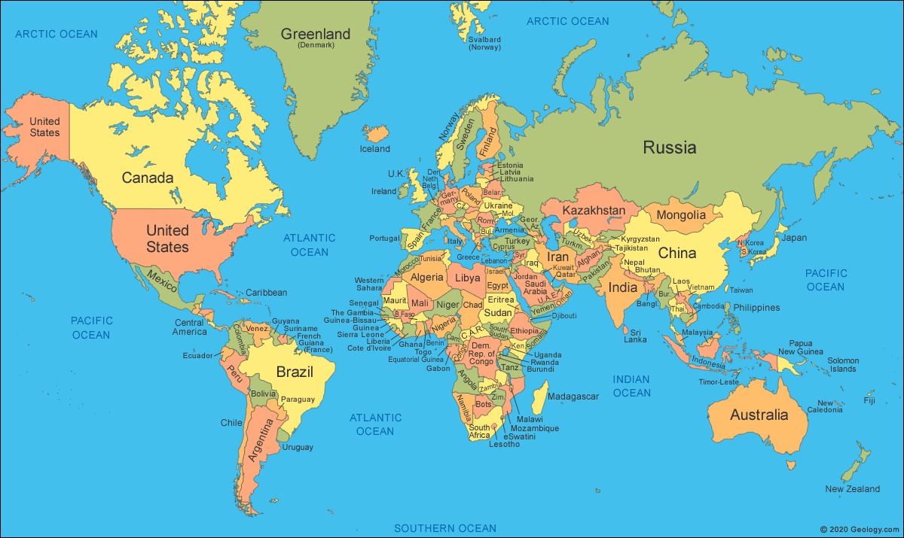
Løveq
Løve
Lev
Lion
Lion
Löwe
Leone
Shīzi
Sinh
León
Leão
Simba
Lion

Slide 15
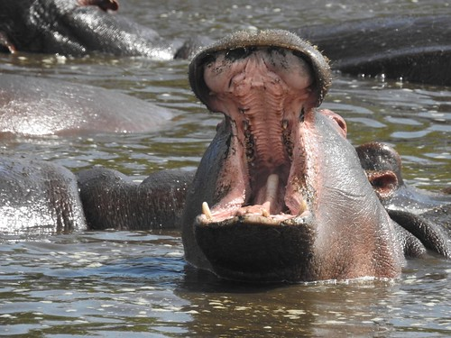
WoLLoW the HiPPo will take you on a journey around the world to explore languages.
Games | Play | Puzzles | Code-breaking
Patterns | Similarities | Differences | Changes
Oddities | Theft | Clues | Fun

Slide 16
Why learn WoLLoW?
The four main ideas behind the WoLLoW course are diversity, communication, curiosity, and connection.
What do you think these words mean?
What is the connection between these four ideas and languages?
How will WoLLoW help you improve your language and communication skills?
How will WoLLoW increase your understanding of other cultures?
DIVERSITY
COMMUNICATION
CURIOSITY
CONNECTION

Slide 17

Diversity, communication, curiosity, connection
WoLLoW aims to inspire you to:
appreciate linguistic diversity and understand how languages are interconnected
improve your language and communication skills
become curious about languages and cultures and eager to explore them beyond the classroom
realize that languages are connected to other topics of study such as geography, science, and arts.

Slide 18
WoLLoW would like to know…
Three things WoLLoW lessons aim to do?
1
2
3

